Slide 1
How to construct DFD, DD and Structure Chart

Slide 2
Supermarket prize Scheme
A supermarket needs to develop the following software to encourage regular customers. For this, the customer needs to supply his/her residence address, telephone number, and the driving license number. Each customer who registers for this scheme is assigned a unique customer number (CN) by the computer. A customer can present his CN to the check out staff when he makes any purchase. In this case, the value of his purchase is credited against his CN. At the end of each year, the supermarket intends to award surprise gifts to 10 customers who make the highest total purchase over the year. Also, it intends to award a 22 caret gold coin to every customer whose purchase exceeded Rs.10,000. The entries against the CN are the reset on the day of every year after the prize winners’ lists are generated.

Slide 3
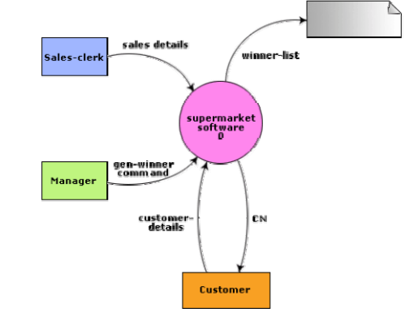
Level 0 DFD

Slide 4
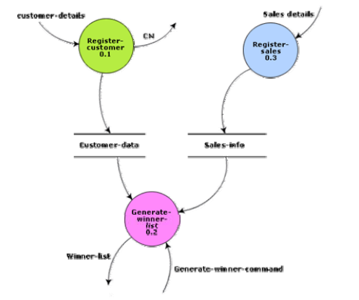
Level 1- 1DFD

Slide 5
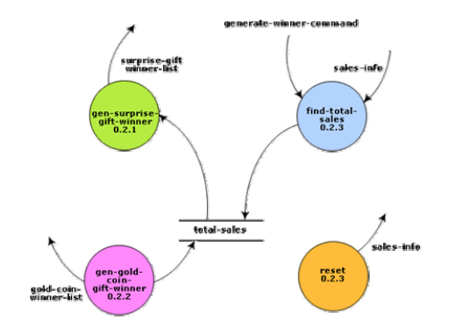
Level 2 DFD

Slide 6
Data Dictionary Rules
+
[,,]
()
{}
=
/* */

Slide 7
Data Dictionary
Address: name+house#+street#+city+pin
Sales-details:{item+amount} *+ CN
CN: integer
Customer-data:{address+CN}*
sales-info: {sales-details}*
Winner-list: surprise-gift-winner-list + gold-coin-winner-list
Surprise-gift-winner-list: {address+CN}*
gold-coin-winner-list: {address+CN}*
Gen-winner-command: command
Total-sales: {CN+integer}*

Slide 8
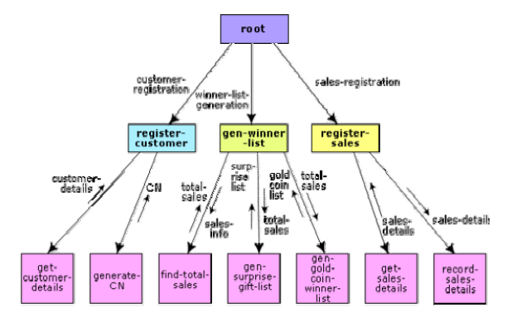
Structure Charts

